Slide 1


Mandatory Participation from Payment:
A payment must be made by one user
Optional Participation from User:
A user does not necessarily need to make a payment if the user does not have any fines
1 – M relationship:
A user can make multiple
Payments but a payment
can only be made by one
user
CONCEPTUAL MODEL WITH CARDINALITIES AND PARTICIPATION
Optional participation from both sides:
A user does not need to reserve a book and
a book does not need to be reserved by a user
1 – M relationship:
A user can reserve many books but a book can only be
reserved by one user
Payment
M
Make
1
1
M
1
Reserve
Pay for
User
Book
1
4
1
Borrow
1
1
Optional participation from both sides:
A user does not need to borrow a book and
a book does not need to be borrowed by a user
1 – M relationship:
A user can borrow up to 4 books but a book can only
be borrowed by one user
Fine
Has
Mandatory Participation from
payment:
A payment must pay for a fine
Optional participation
From fine:
A fine does not need to be
paid by a payment if it has not been paid
1 – 1 relationship:
A fine can only be paid by one payment and a
payment can only pay one fine
Mandatory Participation from Fine:
A Fine must belong to one user
Optional Participation from User:
A user does not necessarily have a fine
1 – 1 relationship:
A user has only one fine that is aggregated by all expired book
borrowings

Slide 2
paymentAmount
CONCEPTUAL MODEL WITH ATTRIBUTES
paymentDate
Payment
M
Make
1
reserveDate
paymentNo
bookID
1
M
1
userID
Reserve
Pay for
User
Book
password
1
4
1
Borrow
bookTitle
Fine
1
1
Has
borrowDate
dueDate
fineAmount

Slide 3
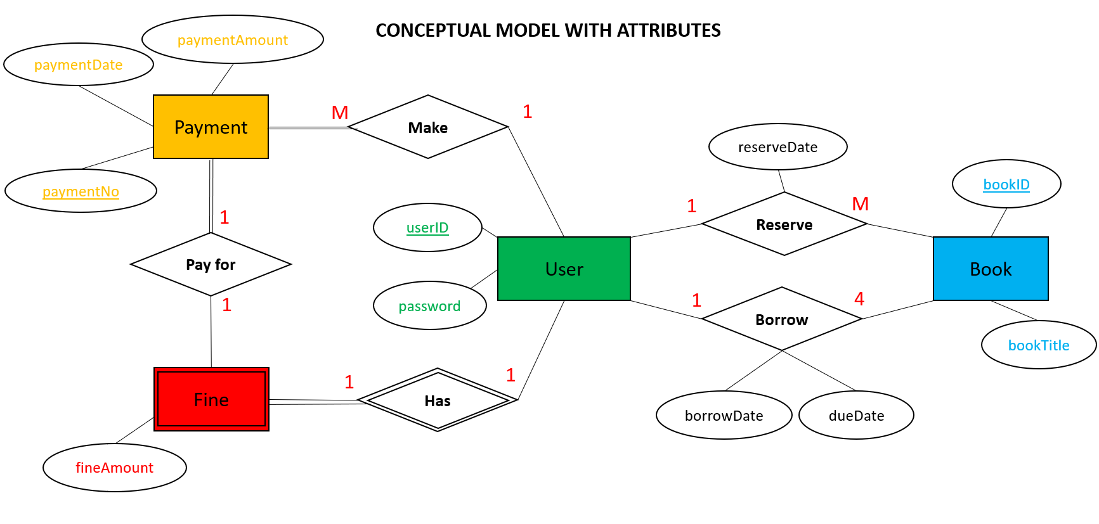
LOGICAL MODEL FORMATION
RELATIONS FROM ENTITIES
RELATIONS FROM RELATIONSHIPS
User (userID, password)
Reserve (userID, bookID, reserveDate)
Borrow (userID, bookID, borrowDate, dueDate)
Make (userID, paymentNo)
Pay for (paymentNo)
Has (userID)
Book (bookID, bookTitle)
Payment (paymentNo, paymentAmount, paymentDate)
Fine (fineAmount)
AdminUser (userID, password)

Slide 4
COMBINING RELATIONS WITH RELATIONSHIPS
User – Payment [ 1 – M relationship with mandatory participation on payment side ]
Payment (userID, paymentNo, paymentAmount, paymentDate)
User – Fine [ 1 – 1 relationship with mandatory participation on fine side ]
Fine (userID, fineAmount)
Payment – Fine [ 1 – 1 relationship with mandatory participation on payment side ]
Fine (userID, paymentNo, fineAmount)
User – Book [1 – M relationship with optional participation on both sides ]
Reservation (userID, bookID, reserveDate)
User – Book [1 – 4 relationship with optional participation on both sides ]
Borrowing (userID, bookID, borrowDate, dueDate)

Slide 5
FINAL RELATIONS
User (userID, password)
AdminUser (userID, password)
Book (bookID, bookTitle)
Payment (userID, paymentNo, paymentAmount, paymentDate)
Fine (userID, paymentNo, fineAmount)
Reservation (userID, bookID, reserveDate)
Borrowing (userID, bookID, borrowDate, dueDate)

Slide 6
FINAL LOGICAL MODEL
Reservation (userID, bookID, reserveDate)
Primary Key userID, bookID
Foreign Key userID references User(userID)
Foreign Key bookID references Book(bookID)
Borrowing (userID, bookID, borrowDate, dueDate)
Primary Key userID, bookID
Foreign Key userID references User(userID)
Foreign Key bookID references Book(bookID)
User (userID, password)
Primary Key userID
AdminUser (userID, password)
Primary Key userID
Book (bookID, bookTitle)
Primary Key bookID
Payment (paymentNo, userID, paymentAmount, paymentDate)
Primary Key paymentNo, userID
Foreign Key userID references User(userID)
Fine (userID, paymentNo, fineAmount)
Primary Key userID
Foreign Key userID references User(userID)
Foreign Key paymentNo references Payment(paymentNo)

